Slide 1





CYBER SECURITY AND FORENSICS
CYBERGUARD PRO
FACULTY GUIDES: DR. AMOL RAJMANE AND PRAMOD DHARMADHIKARI

Slide 2


TEAM MEMBERS
SHUBH DAS - 202301040252
Abhishek Verma - 202301040047
Piyush Dembda - 202301040144
Omkar gavali - 202301040045
jyotiraditya ukey - 202301040061

Slide 3

THE GROWING CYBERSECURITY CHALLENGE
Why Cyber Security Matters Today?
In today’s digital world, organizations heavily depend on websites,
cloud systems, emails, and online services. As technology grows, cyber threats are also evolving rapidly.
Every day, companies face attacks such as:
Phishing emails
Ransomware attacks
Website vulnerabilities
Data breaches
Password leaks
Malware infections
Security analysts often need to use multiple disconnected tools to investigate these threats, making the process slow and inefficient.

Slide 4


OBJECTIVES AND SCOPE
Scope
CyberGuard Pro covers:
OSINT Reconnaissance
Network Security
Threat Intelligence
Web Security Auditing
Digital Forensics
Phishing Detection
Password Analysis
Objectives
Build a Flask-based
cybersecurity dashboard
Integrate multiple security
modules
Generate automated
PDF reports
Use ethical and authorized
testing methods

Slide 5

INTRODUCING CYBERGUARD PRO
CyberGuard Pro is a web-based cybersecurity incident response and security analysis toolkit developed using free and open-source technologies.
The platform integrates multiple cybersecurity domains into a single dashboard, allowing analysts to perform:
OSINT Reconnaissance
Threat Intelligence
Web Security Testing
Digital Forensics
Phishing Detection
Password Analysis
Network Security Assessment
Automated PDF Reporting

Slide 6

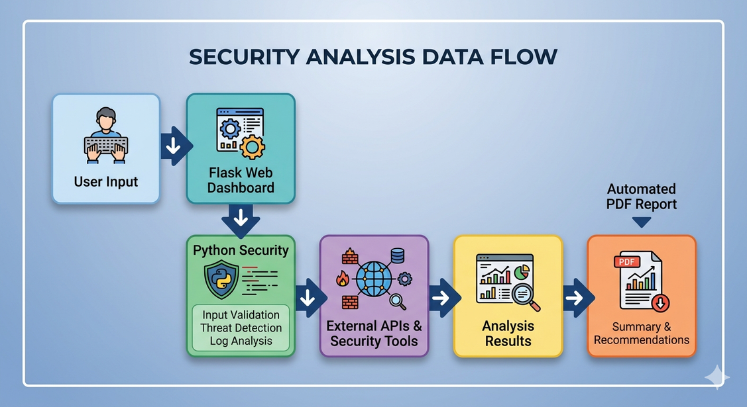
SYSTEM ARCHITECTURE
Working of CyberGuard Pro
Technologies Used
Python
Flask
Bootstrap
Chart.js
Folium
VirusTotal API
Shodan API

Slide 7


CORE MODULES OVERVIEW
Major Modules in
CyberGuard Pro
ModulePurpose
OSINT Reconnaissance: Collects public intelligence about IPs and domains
Network Scanner: Detects open ports and exposed services
Threat Intelligence: Analyzes malicious URLs, hashes, and IP reputation
Web Security Auditor: Identifies website security vulnerabilities
Digital Forensics: Performs metadata and hash-based investigation
Phishing Detector: Detects spoofed and suspicious emails
Password Analyzer: Checks password strength and breach exposure

Slide 8

Technologies & APIs Used
Python + Flask: Backend development and routing
HTML5 + Bootstrap 5: Frontend user interface
Chart.js: Data visualization and charts
Folium: Interactive IP geolocation maps
Shodan InternetDB: OSINT and service intelligence
VirusTotal API: Malware and URL reputation analysis
AbuseIPDB API: IP abuse reputation checking
PwnedPasswords API: Password breach detection
ExifTool: Metadata extraction
Sleuth Kit: Digital forensic analysis
FPDF2: Automated PDF report generation

Slide 9

OSINT + NETWORK SCANNER
Reconnaissance & Network Analysis
OSINT Features
WHOIS Lookup
DNS Enumeration
Shodan Intelligence
IP Geolocation Mapping
Network Scanner
Detects active ports
Identifies exposed services
Calculates risk level

Slide 10

DIGITAL FORENSICS + PHISHING DETECTION
Investigation & Email Analysis
DIGITAL FORENSICS
EXIF METADATA EXTRACTION
MD5 / SHA HASH GENERATION
STRINGS EXTRACTION
SLEUTH KIT INTEGRATION
PHISHING DETECTOR
Email Header Analysis
SPF & DMARC Verification
Spoofing Detection
URL Extraction

Slide 11

PASSWORD SECURITY + PDF REPORTS
Password Analysis & Reporting
Password Security Analyzer
Password strength estimation
Breach detection using PwnedPasswords
Improvement suggestions
Automated PDF Reporting
Consolidated findings
Executive summary
Risk ratings
Professional audit format

Slide 12

TESTING & RESULTS
Testing & Demonstration
Test Targets Used
scanme.nmap.org
testphp.vulnweb.com
localhost
Dummy phishing headers
Key Results
Successful port detection
Threat intelligence working
Vulnerability identification successful
Accurate phishing detection
PDF report generation successful

Slide 13

SECURITY, ETHICS & FUTURE SCOPE
Ethical Practices
Authorized scanning only
Privacy-focused design
No exploitation features
Secure API key handling
Future Enhancements
Real-time scan tracking
CVE database integration
User authentication
Scan history database
MITRE ATT&CK integration

Slide 14

CONCLUSION
CyberGuard Pro successfully integrates multiple cybersecurity domains into one unified platform.
The project demonstrates:
Practical cybersecurity implementation
Full-stack development skills
Ethical security practices
Real-world security analysis capabilities

Slide 15

THANK YOU

